Slide 1
Building a 21st Century Regional Learning and Planning Community A Collaborative Model for Washington County Schools Presented by Terrance Brewer Jerome Steele, Ed.D. November 29, 2012 University at Albany – East Campus 5 University Place Rensselaer, New York 12144

Slide 2
Essential Questions
How do these seven districts share and expand academic opportunities for their students in a cost effective manner?
What is currently being shared among the districts and how can this be improved upon?
Given current structures, what may be shared? What are the obstacles?
What new structures will need to be created in order to be more effective?
What cost savings are associated with these sharing opportunities?
Does the use of instructional technology provide an opportunity for greater sharing?
Page 8 in report

Slide 3
Continuum of Organizational Change from Independence to Merger/Consolidation
Independence
Shared Programs and Services
Tuition Based Schools or Regional Schools
Consolidation/Merger
Modest Sharing to Comprehensive Change,
What level of change is your district ready to support?

Slide 4
Purpose of the Study
The purpose of this study was to determine the ability of these seven school districts to maximize their capability for sharing of services and create short term savings. It was not the purpose of this study to provide financial solutions to very complex financial problems. Nevertheless, some solutions are explored.

Slide 5
Methodology
Quantitative
Data was collected from each school district
Financial data – ST-3, State Aid, Taxes
Enrollment data – Ten years
Academic data (School Report Card)- Graduation rates, etc
Demographic data – Free and reduced lunch
Page 8 in report

Slide 6
Methodology
Qualitative Methodology
Interviews and focus groups with each school district including:
Superintendents
Building principals
Business officials
Directors of curriculum and instruction
Transportation Supervisors
Directors of Buildings & Grounds

Slide 7
Financial Implications A Sense of Urgency
Page 23 in report

Slide 8
Financial Implications Reductions in Staff
Administrators | Teachers | Non Instructional
5.8 | 87.1 | 38
Page 9 in report

Slide 9
Financial Implications
Page 12 in report

Slide 10
Financial Implications
Page 12 in report

Slide 11
Financial Implications
Page 13 in report

Slide 12
Financial Implications
Page 10 in report

Slide 13
Financial Implications
Page 13 in report

Slide 14
Financial Implications
Page 14 in report

Slide 15
Financial Implications
Projected Available Fund Balance
Page 14 in report

Slide 16
Financial Implications Limited/No Control
Employer Contribution Rates for TRS and ERS
 | Teachers’ Retirement | Employees’ Retirement
2008-09 | 7.6 % | 8.5 %
2009-10 | 6.19 % | 7.4 %
2010-11 | 8.62 % | 11.9 %
2011-12 | 11.11 % | 16.3 %
2012-13 | 11.84 % | 18.9 %
2013-14* | 15.5 – 16.5 % | 21 %
*Current estimate
Page 11 in report

Slide 17
Financial Findings
The charts indicate that budgets have been flat or have decreased
Tax levies have been flat
State Aid has been flat or decreased
Increase use of fund balance to offset loss of aid and mitigate tax cap impact
Limited or no control over TRS, ERS, and Health Insurance costs
Page 15 in report

Slide 18
Financial Opportunities
Formalize the sharing that is already in place
Consider creation of a Central Business Office
Collaborate in creating cost efficiencies in the following areas:
Teacher Contracts
Health Insurance
General Liability Insurance
Legal Services
Auditing Services
Page 15 in report

Slide 19
Professional Learning Communities
Develop professional learning communities for all school related operations
Professional Development
Administration
Faculty
Staff
Curriculum and Instruction
Special Education
At risk students
Transportation
Collaboration with BOCES on programs for Myers and SAEC Centers

Slide 20
Administrative Structure and Sharing Opportunities
 | Argyle | Cambridge | Fort Ann | Granville | Hartford | Hudson Falls | Salem
Superintendent | X | X | X | X | X | X | X
Elementary Principal | X | X | X | X | X | X | na
Middle School Principal | na | na | na | X | na | X | na
High School Principal | X | X | X | X | X | X | na
K-12 Principal | na | na | na | na | na | na | X
Principal of Curriculum | na | na | na | na | na | na | X
Director of Curriculum and Instruction | 0 | 0 | 0 | 0 | 0 | 0 | 0
Business Manager | X | X | X | X | X | X | X
Director of Special Education | .5 | 0 | 0 | X | 0 | 0 | x
Transportation Supervisor | 0 | X | X | X | X | X | X
Director of Human Resources | 0 | 0 | 0 | 0 | 0 | 0 | 0
Director of Technology | 0 | 0 | 0 | X | 0 | X | 0

Slide 21
Current Status of Sharing Findings
Special Education Programs
Some teachers are shared
Transportation on an informal basis
Distance learning in only two schools
SUNY Adirondack has provided faculty for some courses
Some professional development
Page 24 in report

Slide 22
Opportunities for Sharing
Stronger formalized partnerships
Potential for sharing teachers across the seven districts
Develop professional learning communities on a variety of levels
Create a regional approach to alternative education
Create a regional approach for a GED program
Stronger coordination with SUNY Adirondack
Page 25 in report

Slide 23
Instructional Program Findings
Each school district has unique strengths within their academic programs
Advanced Placement Courses
Agricultural Science Courses
Engineering Courses
Computer Assisted Design
Advanced Art Classes

Slide 24
Instructional Program Opportunities
Create a Common Bell Schedule
Key step to the “Collaborative Model”
Allow for cross registration in certain courses
Create courses to be taught online
Build capacity to develop online courses
Use interactive instructional tools – Moodle
Creating School Campus Clusters
Bridging with Colleges, Universities and BOCES
Develop Professional Learning Communities to address instructional needs across the districts
Page 27 in report

Slide 25
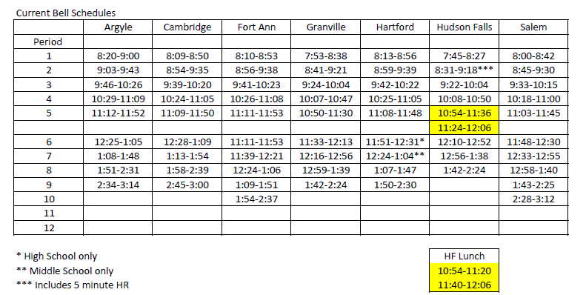
Current Bell Schedule
Page 54 in report

Slide 26
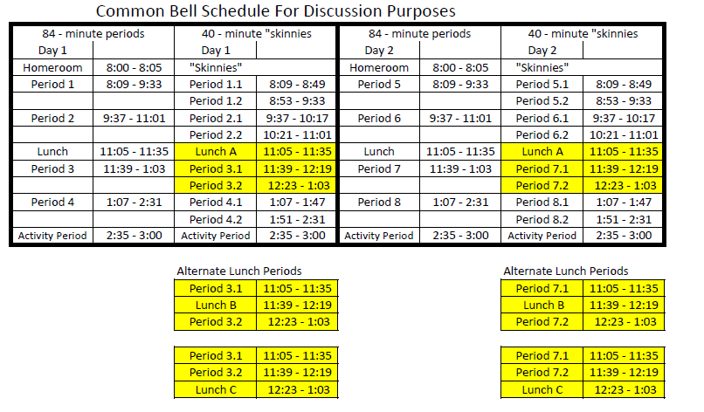
Common Bell Schedule for Discussion
Page 54 in report

Slide 27
Instructional Technology and Distance Learning Findings
All districts have broadband capability
Extensive use of fiber technology
Use of “cloud” technology
Access “anywhere, anytime, any device”
Use of online courses
Five districts have common network support person through WSWHE BOCES
Hudson Falls Technology Coordinator as a regional resource

Slide 28
Instructional Technology and Distance Learning Opportunities
“Anywhere, Anytime, Any Device”
Introduce “Cloud” technology
Collaborate to develop online and hybrid courses
Use new technology to implement distance learning
Use resources such as Khan Academy
http://www.khanacademy.org/
Page 29 in report

Slide 29
Transportation
Create a professional learning community to:
Investigate the most efficient use of resources
Collaboration with transportation to Myers or SAEC
Collaboration with transportation for Special Education
Collaboration with transportation for Non-public students
Consider the advantages and disadvantages of a regional maintenance facility
Page 30 in report

Slide 30
Why this proposal?
When we met in March 2012, we were asked to develop a model for collaborative education in Washington County
Regional High School Legislation has not been enacted
School District Consolidation is difficult
Communities do not want to lose their identity
Financial constraints are forcing districts to think differently about how they allocate their resources
We believe a collaborative regional learning and planning community based on campus clusters and expanded technologies provides both short and long term opportunities

Slide 31
Regional High School vs. School District Collaborative
Regional High School Legislation is not adopted
Regional High School Legislation calls for loss of identity
Collaborative model maintains school and community identity
Collaborative model maximizes academic opportunities
Collaborative model allows for cost efficiencies
Page 35 in report

Slide 32
Washington County School District Collaborative
Argyle
Cambridge
Fort Ann
Granville
Hartford
Salem
Hudson Falls
Page 37 in report

Slide 33
Washington County School Collaborative A 21st Century Regional Learning and Planning Community
Argyle
Cambridge
Fort Ann
Granville
Hartford
Hudson Falls
Salem
SUNY
Adirondack
WSWHE
BOCES
Director of Special Education
Director of Human Resources
Director of Professional Development and Curriculum and Instruction
Professional Learning
Communities
Central Business Office
Central Registrar
Chief Information Officer
Governing Board
Superintendents
Board Presidents
School/Community and Business Partnerships
Page 42 in report

Slide 34
Sample School Campus Clusters
Salem
Argyle
Cambridge
Fort Ann
Granville
Hartford
New District
Page 38 in report

Slide 35
Sample School Campus Clusters
Argyle
Hudson Falls
Cambridge
Hartford
Fort Ann
Argyle
Hartford
Granville
Salem
New District
Page 38 in report

Slide 36
Sample School Campus Clusters
Fort Ann
Argyle
Hartford
Granville
Salem
Hudson Falls
New District
Page 38 in report

Slide 37
Sample School Campus Clusters
Fort Ann
Argyle
Hartford
Granville
Salem
Hudson Falls
Cambridge
BOCES
New District
Page 38 in report

Slide 38
Summary of Opportunities for Consideration
Creation of the Washington County Collaborative
Creation of a Collaborative Governing Board
Common Bell/Teaching Schedule for Washington County HS
Director of Special Education
Director of Human Resources
Director of Professional Development/Curriculum and Instruction
Central Registrar
Central Business Office
Director of Instructional Technology
Development of a coordinated regional transportation plan
Developing and building capacity through professional learning communities
Page 39 in report

Slide 39
Building Stronger School/Community and Business Partnerships
“Rural schools are an important source of community solidarity, a primary node of social interaction and community reproduction, and often are the largest employers in rural areas.”
Schafft, Alter, and Bridger (2006)
Page 43 in report

Slide 40
Career Opportunities in Rural Education
http://www.coreinstitute-milford.org
http://www.youtube.com/watch?v=_-l8oPsNRLM&feature=channel
Page 44 in report

Slide 41
Potential Savings Through Collaboration
By sharing positions it creates cost efficiencies
By sharing teachers and other staff, it allows for better utilization of their expertise
If positions are created through BOCES as a shared service, greater cost savings occur
By creating campus clusters, students will be able to take advantage of academic opportunities
Pages 46- 47 in report

Slide 42
Phases of Implementation
Phase 1 2012 – 2013
Create Collaborative Advisory Committee
Create Common Bell Schedule
Identify clusters and magnet programs
Review and discuss existing, shared, or new administrative positions*
Develop plan for implementing shared positions
Develop technology infrastructure for clusters and magnets
Develop Professional Learning Community structures
Page 48 in report

Slide 43
Phases of Implementation
Phase 2 2013 – 2014
Continue Professional Learning Community structures
Develop long term financial plans
Evaluate revenue streams and aidable programs and services
Strategic Planning for regional collaboration
Evaluating program adjustments for staffing and academics
Page 48 in report

Slide 44
Phases of Implementation
Phase 3 2014 – 2015
Develop collaboration with towns, colleges businesses and community
CORE Institute model for collaboration
Continued collaborative model evaluation
Regional contract assessment
Teacher Contract
Health Insurance
Liability Insurance
Others?
Page 48 in report

Slide 45
Final Thought
“These findings support the conclusion that, under some circumstances, shared administrative and instructional services across districts function as a workable compromise between complete district autonomy and extensive consolidation.”
Howley, Howley, Hendrickson, Belcher and Howley (2012)

Slide 46
Discussion, Clarification and Questions
Does the collaborative model work for your seven school districts?
If yes, then how do you involve your school district and community in understanding the “collaborative”?
How can CASDA assist you in building this regional learning community for the 21st century?

